Slide 1
Denoising Diffusion Probabilistic Models
Taharina Tasnim (115613595)

Slide 2
Why Generative Models?
Their primary function is to understand and capture the underlying patterns or distributions from a given set of data. Once these patterns are learned, the model can then generate new data that shares similar characteristics with the original dataset.
Why Diffusion based Generative Models?
Compared to traditional generative models, diffusion models have - ease of training with simple and efficient loss functions, generate highly realistic images, interpretable latent space, and robustness to overfitting.

Slide 3
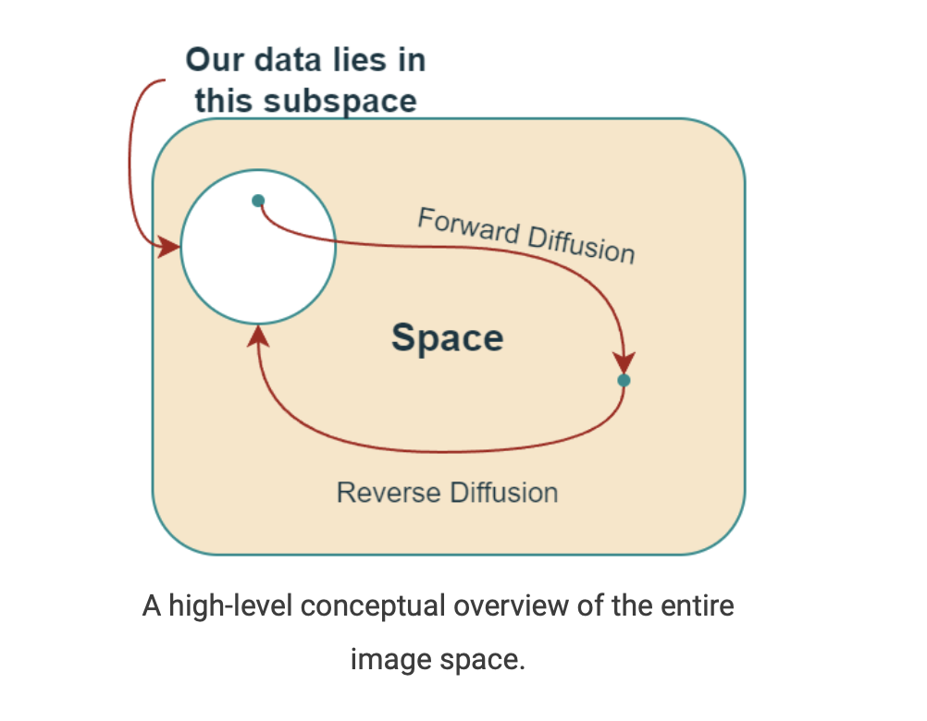
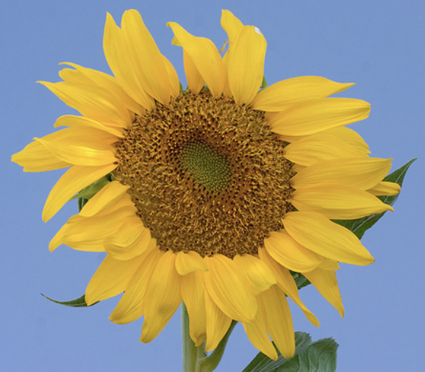

Slide 4
Forward Diffusion Process:
“It’s easy to destroy but hard to create” – Pearl S. Buck
We slowly and iteratively add noise to (corrupt) the images in our training set
What we are doing here is converting the unknown and complex distribution that our training set belongs to into one that is easy for us to sample
At the end of the forward process, the images become entirely unrecognizable

Slide 5
Reverse Diffusion Process:
We slowly and iteratively try to reverse the corruption performed on images in the forward process
However, the problem is that we can take infinite paths starting from a point in this simple space, but only a fraction of them will take us to the data subspace.

Slide 6
Reverse Diffusion Process:
In forward diffusion process the PDF that satisfies the corrupted images differs slightly at each step
Hence, in the reverse process, we use a deep-learning model at each step to predict the PDF parameters of the forward process
And once we train the model, we can start from any point in the simple space and use the model to iteratively take steps to lead us back to the data subspace.

Slide 7
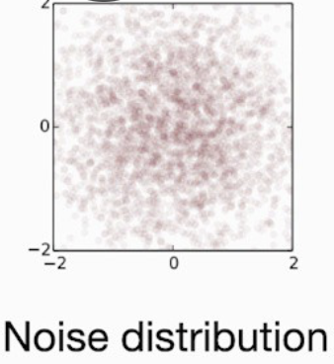
X_{T}
P(X_{T})

Slide 8
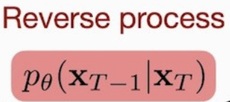
X_{T}
X_{T-1}
P(X_{T})
P_{θ}(X_{T-1})

Slide 9
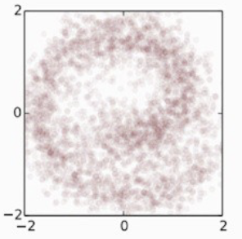
X_{T}
X_{T-1}
X_{t}
P(X_{T})
P_{θ}(X_{T-1})
P_{θ}(X_{t})

Slide 10
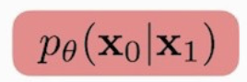
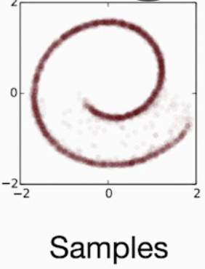
X_{T}
X_{T-1}
X_{t}
X₁
X₀
P(X_{T})
P_{θ}(X_{T-1})
P_{θ}(X_{t})
P_{θ}(X₁)
P_{θ}(X₀)

Slide 11
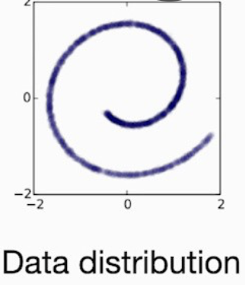
X_{T}
X_{T-1}
X_{t}
X₁
X₀

Slide 12
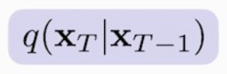
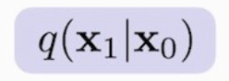
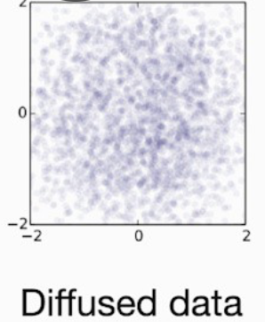
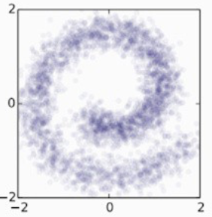
X_{T}
X_{T-1}
X_{t}
X₁
X₀
Forward Process

Slide 13

Loss
Notes:
authors take inspiration from VAEs and reformulate the training objective using a variational lower bound (VLB)

Slide 14

Loss
Notes:
this loss function is huge! But the authors of DDPM further simplify it by ignoring some of the terms in their simplified loss function.

Slide 15
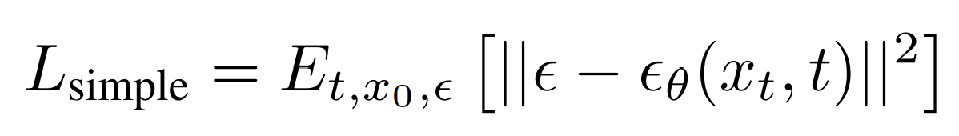
Loss
Notes:
The simplified (after ignoring some weighting terms) loss function used in the Denoising Diffusion Probabilistic Models is as follows:
This is the final loss function they use to train DDPMs, which is just a “Mean Squared Error” between the noise added in the forward process and the noise predicted by the model. This is the most impactful contribution of the paper Denoising Diffusion Probabilistic Models.

Slide 16
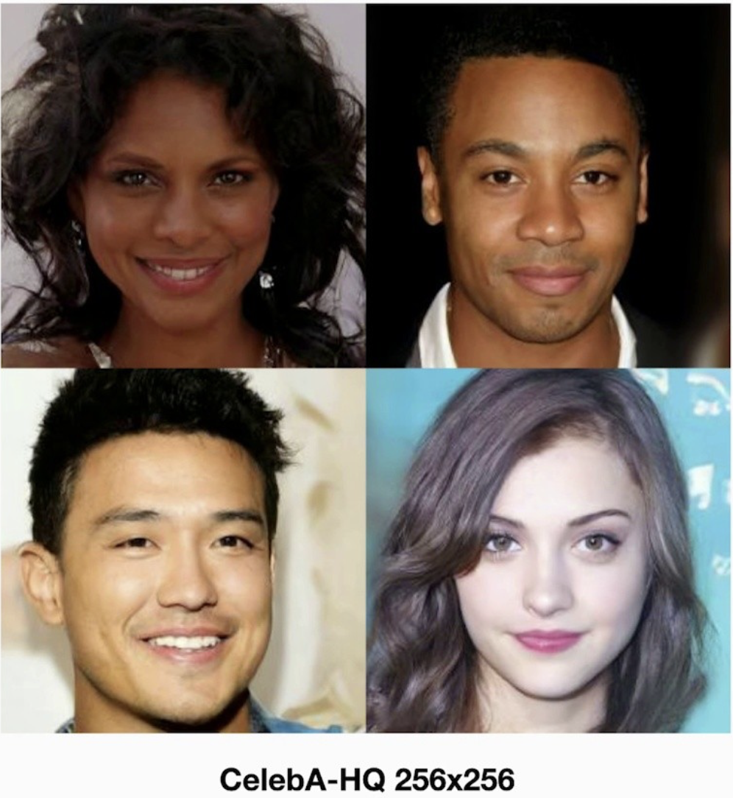
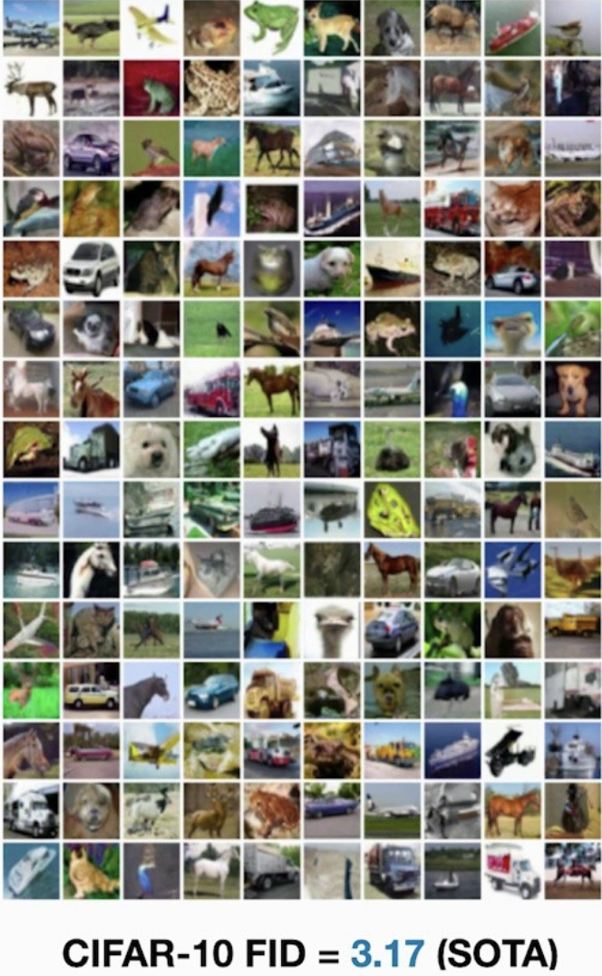
Notes:
New sample data quality

Slide 17
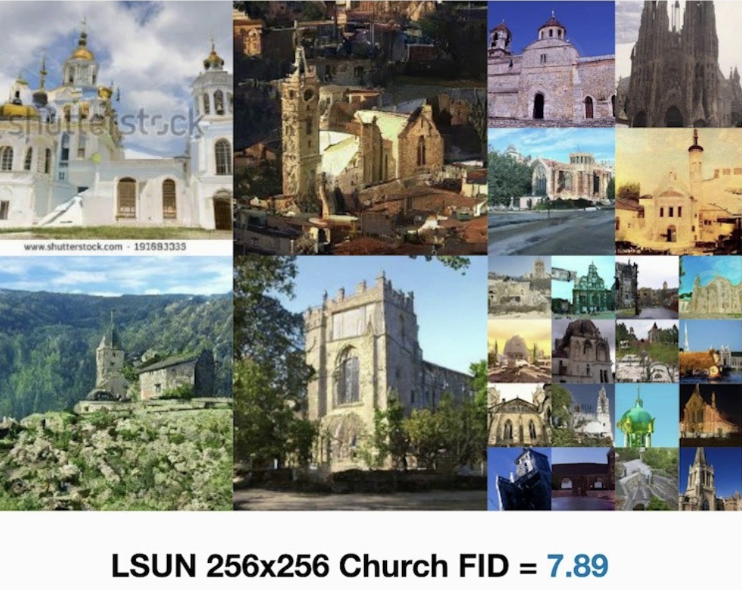
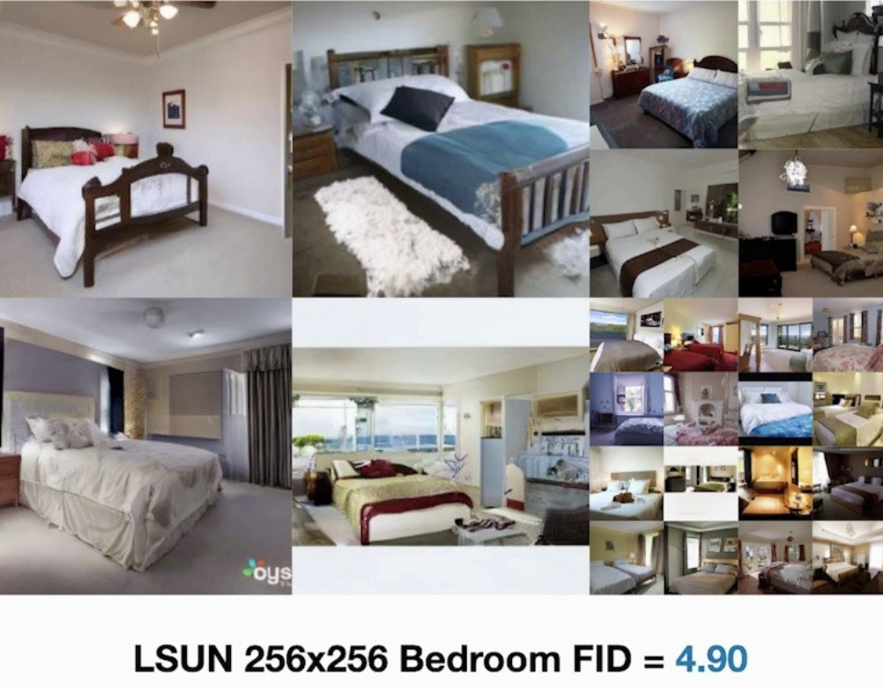
Notes:
On LSUN, their model is comparable to Progressive GAN

Slide 18
Official AI Art Generation Tools using Diffusion Models
The real wave of AI art generation was started by four organizations/websites.
DALL-E 2 by OpenAI
Imagen by Google
Stable Diffusion by StabilityAI
Midjourney by an organization with the same name
Except for Imagen, all other models are accessible either through APIs or GitHub repositories.

Slide 19
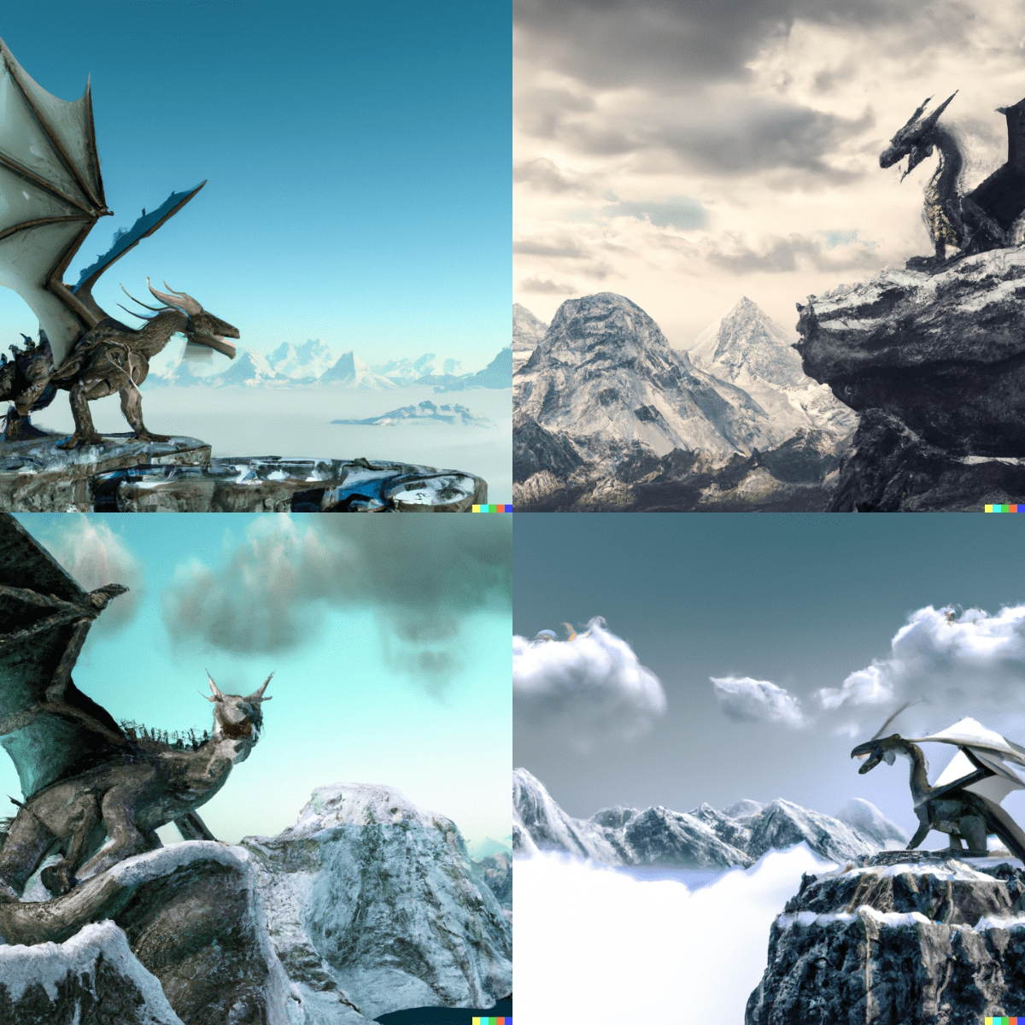
Image generated using DALL-E 2.
Prompt: a dragon standing on top of a mountain, snowy mountains in the background, artistic

Slide 20
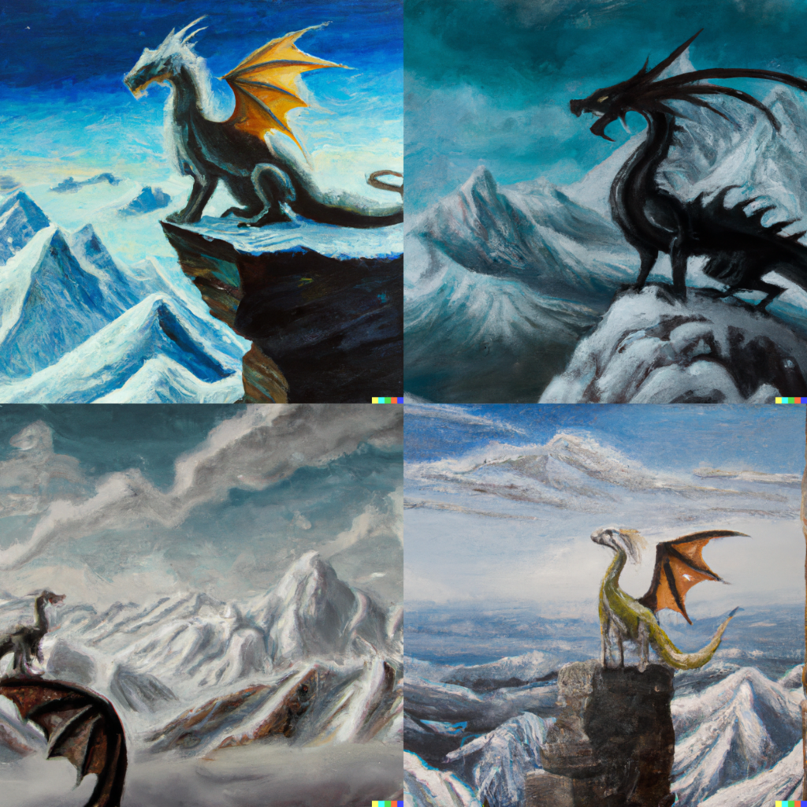
Image generated using DALL-E 2.
Prompt: a dragon standing on top of a mountain, snowy mountains in the background, artistic, oil painting

Slide 21
References
Inspired by the talk from Neurips - https://slideslive.com/38936172/denoising-diffusion-probabilistic-models
Paper link -
https://arxiv.org/abs/2006.11239

